Slide 1
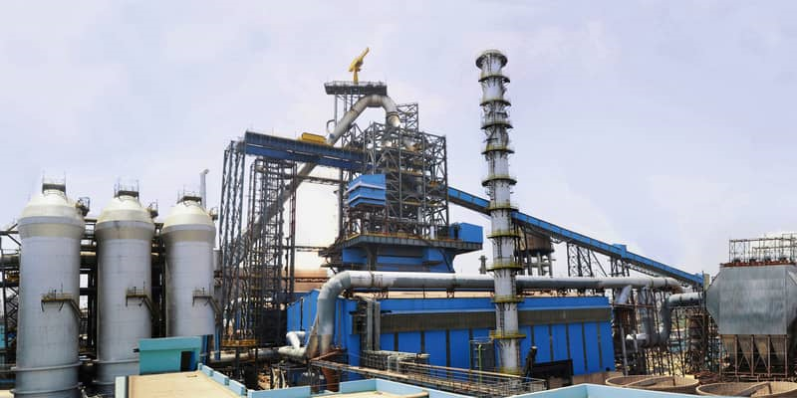

ROURKELA STEEL PLANT

Slide 2
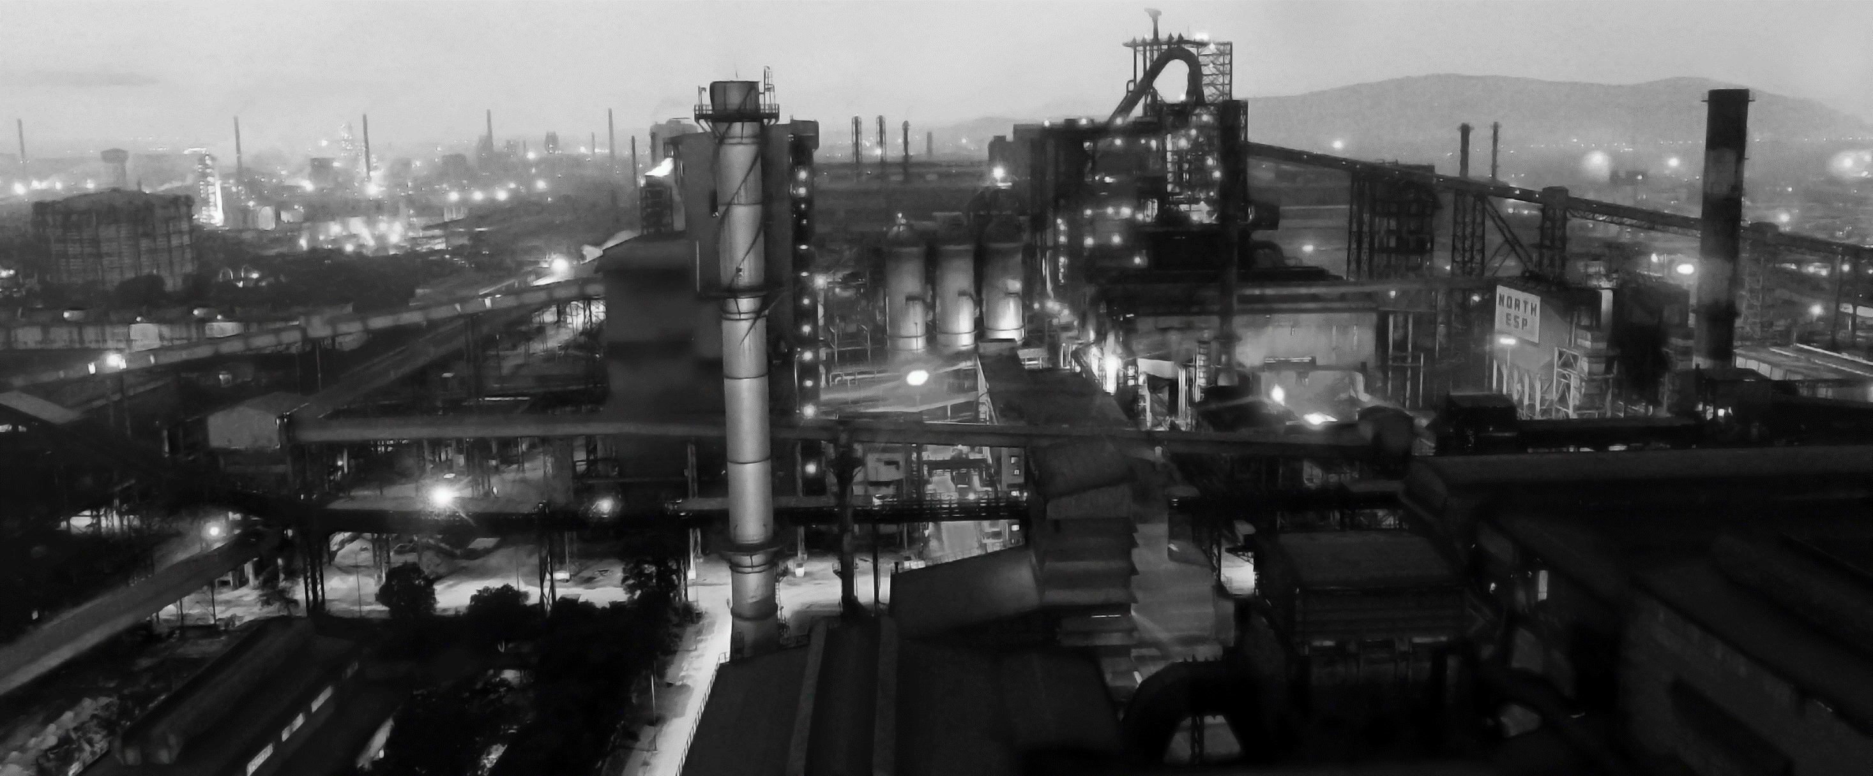
Crude Steel capacity:
Phase - I
Phase - II
Phase – III 2012 - 2015
1965 - 1969
1989 - 1999
Increased from 1 MT to 1.8 MT to cater to flat products market.
Increased to
1.9 MT, old units modernized.
Increased to
4.2MT
Notes:
To cater to the additional demand of flat products decision was taken to expand the Plant to the crude steel producing capacity of 1.8 MT.
To overcome technological obsolesce and to remain competitor in the market, RSP went for further modernisation during 1989-1999 to a crude steel capacity of 1.9'MT and after that
RSP has just concluded its 3rd phase of capacity enhancement with latest technology input to increase economy of scale, enlarge customer base, improve labour productivity, adherence of environment norms and better techno economics.

Slide 3
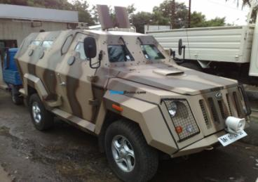
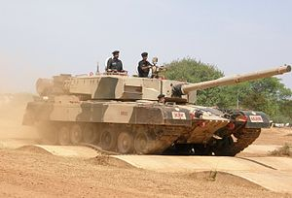
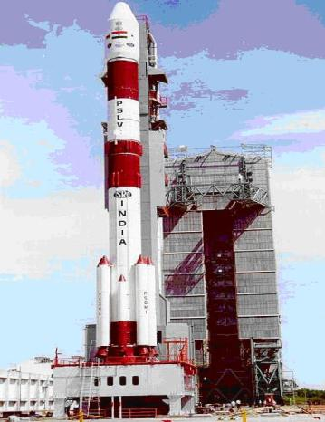
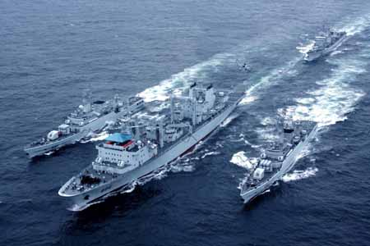
Our Pride

Slide 4
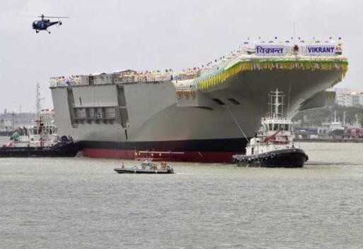
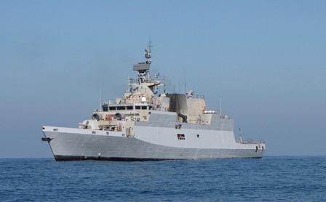
RSP supplied DMR-249A & 249B grade steel for INS Vikrant – the 1st indigenous aircraft carrier
INS KAMORTA the 1st indigenous anti-submarine warship

Slide 7


Slide 9
ENERGY CONSERVATION PROJECTS: THERMAL
Year of implementation of the ECM | Energy/Fuel Savings through ECM |  |  |  |  |  | Investment (in ₹ lakh)
 | 2018-19 | Unit | 2020-21 | Unit | 2021-22 | Unit
2018-19 | 37096000 | Mcal
2020-21 |  |  | 33159230 | Mcal
2021-22 |  |  |  |  | 169372000 | Mcal | 221
2021-22 |  |  |  |  | 8143728 | Mcal | Commissioning of new unit ( Installtion cost 2600 crore)

Slide 10
ENERGY CONSERVATION PROJECTS: ELECTRICAL
S. No. | Name of ECM (Energy Conservation Measure) Implemented | Year of implementation of the ECM | Energy Savings through ECM (kWh) |  |  |  | Investment (in ₹ lakh)
 |  |  | 2018-19 | 2019-20 | 2020-21 | 2021-22
1 | Increase in power generation through WHRS in BPTG of COB-6 | 2018-19 | 6044400 |  |  |  | Nil (In House)
2 | Modification of flow element in BFG U/f line to COB#6 | 2019-20 |  | 23028000 |  |  | Nil (In House)
3 | Increase in power generation in PBS by supplying more BF Gas | 2020-21 |  |  | 47324400 |  | Nil (In House)
4 | Replacement of 20MVA transformer with 25MVA transformer at TRTG at Blast Furnace-V | 2021-22 |  |  |  | 3840000 | 148
5 | Installation of VVVF drives in ID fans of converter A & B in SMS-II | 2019-20 |  | 2411271.75 |  |  | 446
6 | Stoppage of Hot Well pumps in cooling tower of SMS-II Caster | 2021-22 |  |  |  | 1314000 | Nil (In House)

Slide 11
INNOVATIVE PROJECT IMPLEMENTED-1
Replacement of 20MVA transformer with 25MVA transformer at TRTG(Top Recovery Turbogenerator ) Blast Furnace-5 :
Problem: 1. TRTG is provided in BF-5 to produce electrical power by utilizing top gas pressure. It was designed to produce 14 MW power with generator Maximum capacity of 20MW. The installed transformer capacity was of 20MVA and power generation was locked at 14.8 Maximum. After commissioning and full capacity furnace operation it was noticed that the TRT sub-bypass valve remains open even after 14MW , which indicates that the possibility of increase in power generation but could not be done due to constraint in transformer capacity.

Slide 12
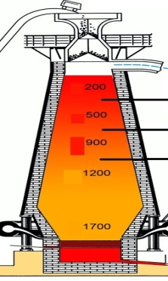


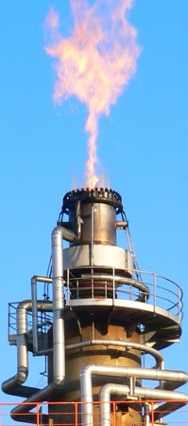
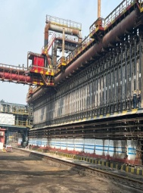

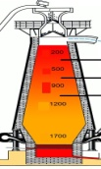
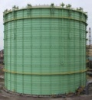
Line diagram of BFG in RSP (Replacement of Transformer)
BF-V Stoves
PBS
BPCV
Turbo Blowers & Cogeneration
PCV
MBCV
SBCV
TRTG
TRTG
BF-5
Flare Stack
PCV
COB#6
Interconnection with old grid
Flare Stack
MT COB
BF-4
EXP COB
BFG Holder
CPP-I
To GMT
BF-1

Slide 13
INNOVATIVE PROJECT IMPLEMENTED-1
Job done:
A task force was formed to study and implement the recommendation.
A new Transformer with capacity of 25MVA was installed in place of old 20MVA Transformer.
Limit of generation at 14.8 MW max was increased to 17.5MW.
Benefits accrued
Increased average annual power generation 0.5MW.
Smooth pressure control through TRT and no sub-bypass valve opening.
Better regulation of BF Gas grid pressure at BF-V.
Total financial benefit 298 Lakhs per annum.
The above modification of replacement of 20MVA transformer with 25MVA transformer at TRT (Top Recovery turbine ) Blast Furnace-5 is recurring in nature hence forth.

Slide 14
INNOVATIVE PROJECT IMPLEMENTED-2
Redesigning of flow element in BFG u/f line of Coke Oven Battery-6
Background
There was constant complain of getting low un-control pressure of BFG(Blast Furnace Gas) from coke oven battery-6 and there by adversely affecting the battery operation. As the battery consumes gas intermittently and it does not take gas for some time interval and was creating pressure surge in BFG grid which in turn causing BF#5 flare stack PCV (setting 800mmwc) to open for flaring of gas. This opening of BFG #5 flare stack was creating pressure reduction to 500mmwc for 3-4 minutes and thus un-control pressure to battery falling below 280mmwc for 3-5 minutes. This phenomenon used to happen 24 times in a shift.

Slide 15

Redesigning of flow element in BFG u/f line of COB-6
Line diagram
Pressure
0.14 Kg/cm²
BPCV
(Turbo Blower and Cogeneration)
Top pressure
2.5 Kg/cm²
PBS
Flow element replaced
bypass
PCV
NB 2400
Stoves
A
TRTG
NB 1600
A1
A2
To COB#6
PCV
Flare Stack
Ram Side
coke Side
To old grid:
Max pressure
400-450mmwg
A- Orifice in main header
A1 & A2- Orifice to branch line

Slide 16
INNOVATIVE PROJECT IMPLEMENTED-2
Modifications done
After elaborate survey of pressure in BFG line to Battery-6, it was noticed that there is excessive pressure drop across orifices installed within the battery limits of COB#6. The first such survey was done in Aug’2019. The orifice data sheet and pressure survey data was analyzed and found that the orifice design to be modified to have lesser pressure drop across orifice.
Benefits accrued
Power generation in PBS(Power & Blowing Station) has also gone up from monthly avg. of about 8 MW to 18MW from Jan’20 onward due to higher availability of BF gas.
Low un-control BFG pressure to battery-6 duration has been eliminated, which led to improvement in coke quality.
Energy input matrix in CPP-1 power generation changed drastically on account of higher BF gas availability in the system and energy matrix was 36.7%coal, 28.8%BF gas and 34.05% Mixed gas in 2019-20 whereas in 2021-22, it was 5.52%coal, 50.6%BF gas and 43.88% Mixed gas. Drastic reduction in coal consumption helped in cost optimization towards coal procurement and also lower CO₂ emission.

Slide 17
INNOVATIVE PROJECT IMPLEMENTED
Redesigning of flow element in BFG u/f line of COB-6
Consumption data of BF gas and Coal at CPP-1 & PBS
 | BFG Generation | BFG to PBS | LDO to PBS | Power gen. In PBS | BFG to CPP-I | MG to CPP-I | FO cons. In CPP-I | HP coal cons. In CPP-I | Power gen. In CPP-I
 | Th.Nm3/hr | Th.Nm3/hr | KL | MW | Th.Nm3/hr | Th.Nm3/hr | KL | T | MW
2018-19 | 742.40 | 163.60 | 2947.00 | 8.47 | 65.90 | 14.60 | 203.00 | 140978.00 | 30.10
2019-20 | 708.48 | 158.30 | 3696.00 | 10.10 | 57.42 | 16.42 | 211.00 | 170885.00 | 37.13
2020-21 | 738.3 | 183.90 | 1171.00 | 15.53 | 91.10 | 17.90 | 383.00 | 70881.00 | 33.80
2021-22 | 838.3 | 176.70 | 1418.00 | 15.31 | 110.7 | 21.90 | 13.00 | 23800.00 | 34.87

Slide 18
Each hot & cold well consists of 4 motor, with 75 kw power.
In running condition only 2 motor runs throughout the year and the other 2 would be in standby mode.
Flow of each pump = 700 m3/hr of water.
Stopping of pump operation in SMS-II
Cold well Hot well
Caster 1 & 2
Cooling tower
C1 C2 C3 C4
H1 H2 H3 H4

Slide 19
Future Energy Conservation Projects
Installation of TRTG(4MW) in Blast furnace -1
Installation of 2.0 MT Pellet plant to improve BF productivity.
Installation of Coke Oven Battery with stamp charging and CDCQ.
Up-gradation TA-6(Turbo Alternator)
Up-gradation of Tandem Mill & Pickling Line in CRM

Slide 20
Initiative taken for Renewable Energy
10 MW Hydel power will be installed in collaboration with State Govt. at Mandira dam.
Feasibility is being carried for floating solar (FPV) unit at Mandira dam(about 100 MW).

Slide 21
THANK YOU

